Slide 1
Bit 302 software engineering
Luh Wulandari Maharani (E1700873)
Rivaldo Bagus Soepardhy (E1700882)

Slide 2
Introduction
Every software development must have a clear and understandable requirement or specification to ensure developers can keep developing software within the boundary of requirement, while also, developer can adjust to what users need with the software, and developers can optimize the software according to users’ need.

Slide 3
Project Aims
To change the traditional way of transaction & interaction between government and people about micro housing.
To provide easier way for government to manage house rent for youths with low wages.
To provide efficient and convenient way of youths in search of boarding house with affordable price.

Slide 4
FUNCTIONAL REQUIREMENT
HousingOfficer requirement
HousingOfficer has login menu that can be filled with user ID and password to go directly to HousingOfficer homepage.
HousingOfficer can change the password if HousingOfficer forget their password.
HousingOfficer must have “edit menu” which is can edit residence detail.
HousingOfficer must have “add menu” which is can set up new residence.
HousingOfficer must have “delete menu” which is can delete applicant and residence detail.
HousingOfficer must have “view menu” which is can view applications and residence details.
Payment menu to display payment details for applicant, which is designed by HousingOfficer.
Logout Menu to exit from the application.

Slide 5
FUNCTIONAL REQUIREMENT
Applicant Requirement
Applicant will register where the form has been given.
Applicant has login menu that can be filled with user ID and password so that the applicant can access the system without confusion, and will be directed to the home page.
Applicant can change the password if applicant forget their password.
The system has a menu with buttons or icons that applicants can choose from view application, view residences, wish list, submit applications and payment.
Logout Menu to exit from the application.

Slide 6
NON-FUNCTIONAL REQUIREMENT
Requirement | Description
Security requirement | Using login system for authorization to prevent unauthorized access of certain parties.
Usability | The system should be easy to access for Housing Officer and Applicant.
Integrity | Data inside the system will be keep as it is untampered and unharmed.
Modifiability | Data can only be change by authorized user (HousingOfficer).

Slide 7
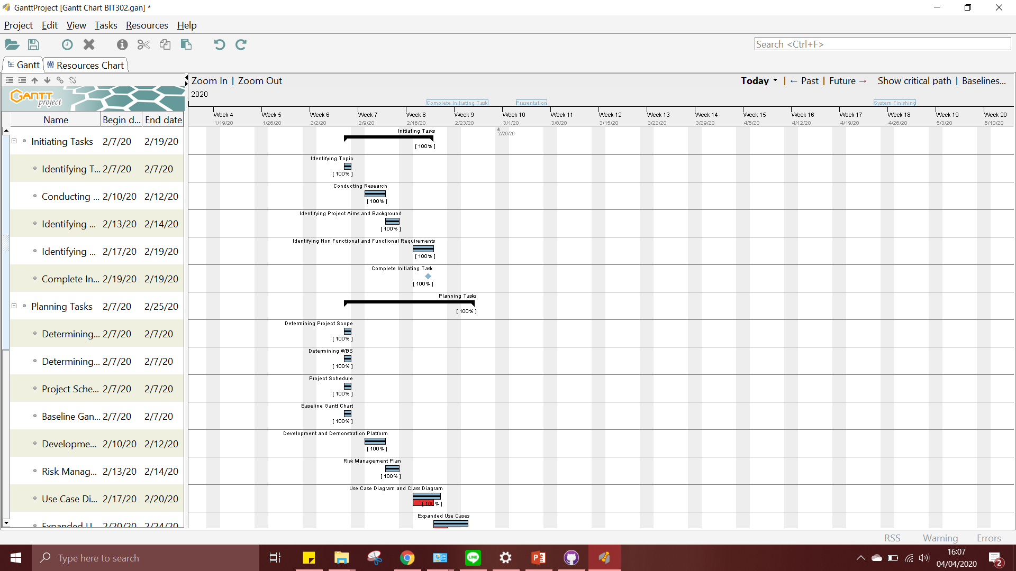
Gantt Chart

Slide 8
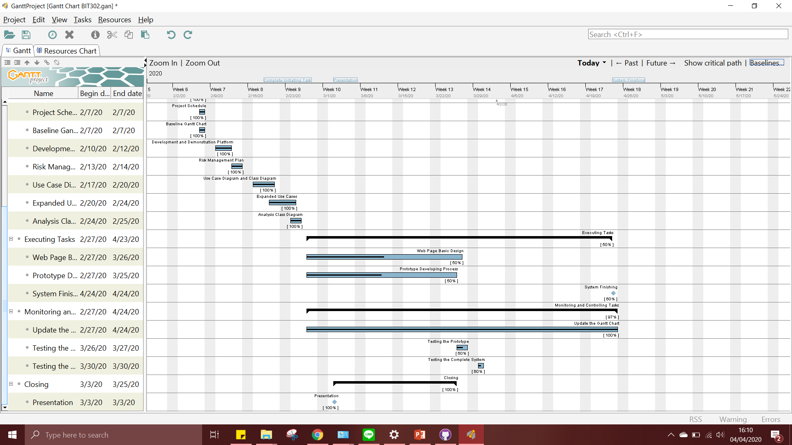
Gantt Chart

Slide 9
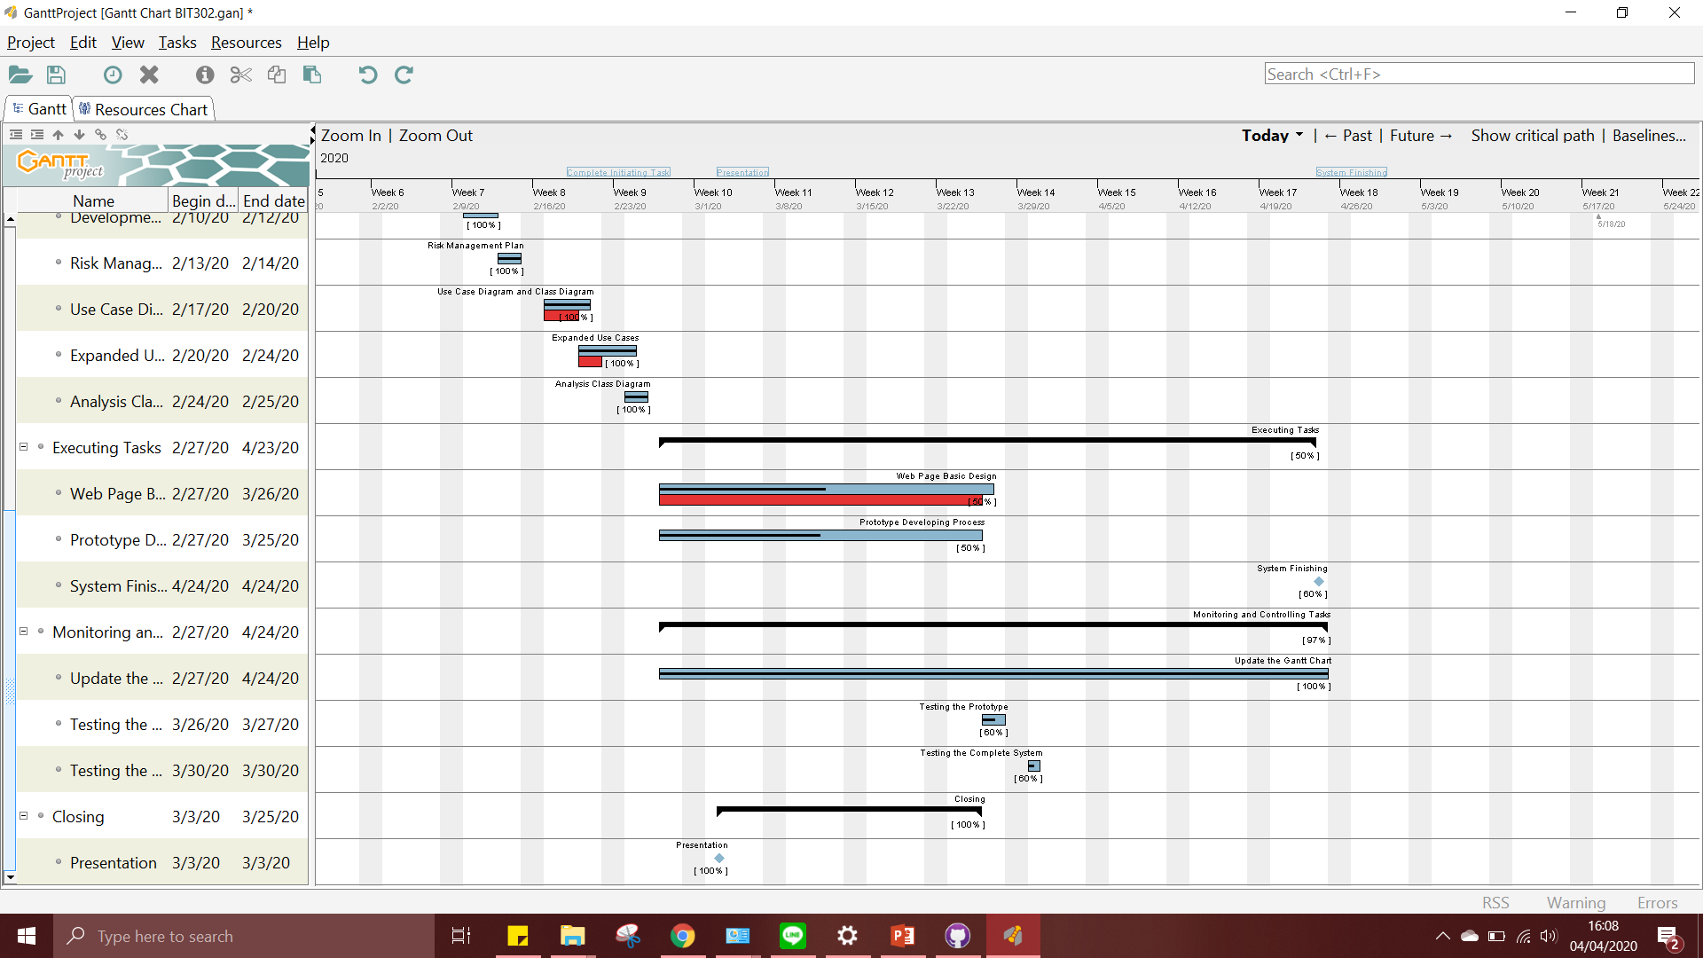
Baseline Gantt Chart

Slide 10
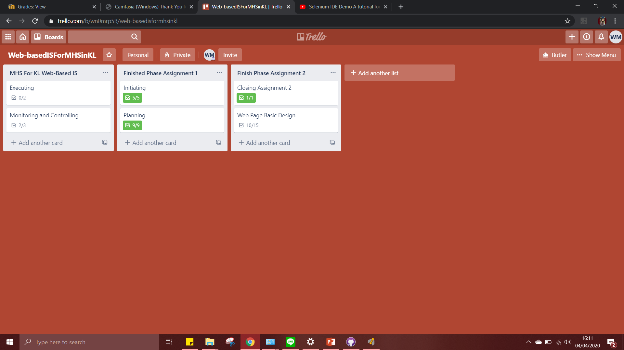
Trello

